Slide 1
Campanile Carillon Model
sddec19-12
http://sddec19-12.sd.ece.iastate.edu/
Dr. Tin-Shi Tam & Dr. Gary Tuttle
Gabriel Stackhouse, Ryan Roltgen, Kienan Otto, Yicheng Hao, Grant Mullen, Sam Habel

Slide 2
Problem Statement
The campanile is a defining symbol of Iowa State University
Not many people get to hear or play the bells on an actual carillon
A Mobile Campanile Carillon is being constructed to allow anyone to have the experience of playing a carillon
A tutorial will be made to help others play the carillon even if they are unfamiliar with the instrument
Notes:
Ryan

Slide 3
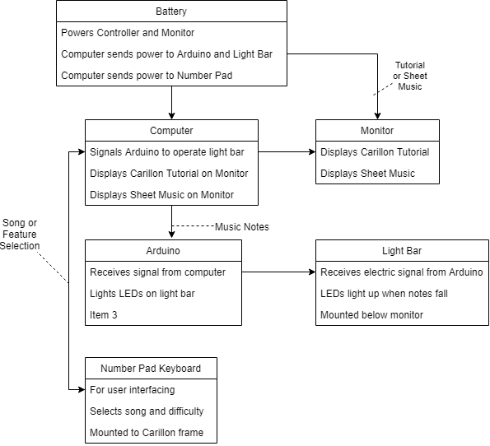
Conceptual Sketch
Notes:
Ryan

Slide 4
Functional Requirements
Display falling notes onto keys
Light up LEDs corresponding to each key
Operate on battery power for 8 hours
Have an intuitive user interface
Have tempo control difficulty options
Implement different game modes
Allow reading PDF sheet music
Notes:
Grant

Slide 5
Non-functional Requirements
System must be safe for others to use
System needs to be reliable and consistent
System must fit into the space constraints of the model
System should work in many conditions (hot, cold, slight rain)
System should be visually pleasing
Notes:
Grant

Slide 6
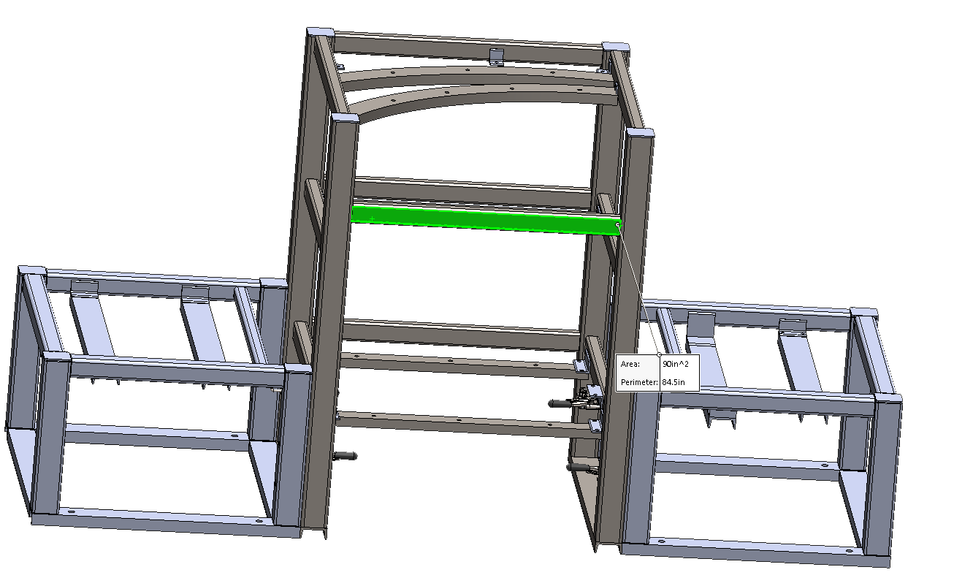
Other Constraints and Considerations
Continuing work from a previous Senior Design group
Working with ME 415 team to integrate the hardware and frame
ME 415 group will change between Spring and Fall semesters
Tight space constraints means placing electronics will be difficult
Waiting on construction of specialized hardware
Notes:
Grant

Slide 7
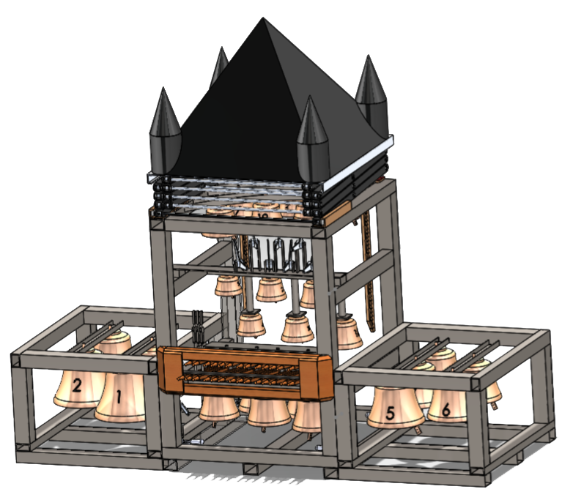
Market Survey
Only fourteen total mobile carillons in the world
Only two other mobile carillons in the United States
No other mobile carillons in existence have a tutorial element
The Iowa State branded mobile carillon will be a significant point of interest and eye-catching object at various events
Notes:
Sam

Slide 8
Resource and Cost Estimate
Widescreen outdoor monitor ≅ $1200
Current computer ≅ $200
Possible upgrade ≅ $400
Battery Solution ≅ $350
Control Method ≅ $50
Miscellaneous Electronics < $100
Total ≅ $2300
Notes:
Sam

Slide 9
Project Milestones & Schedule
Windows Port
Rewrite software to run on Windows 10 instead of Linux Mint - April 19
Functional tutorial mode
Able to add additional songs - March 7
Achieve consistent performance - March 27
Add difficulty levels - April 14
UI overhaul - April 21
Power System
Prototype the battery indicator design - April 11
Notes:
Sam. Consistent Performance: Stable refresh rate at full monitor resolution

Slide 10
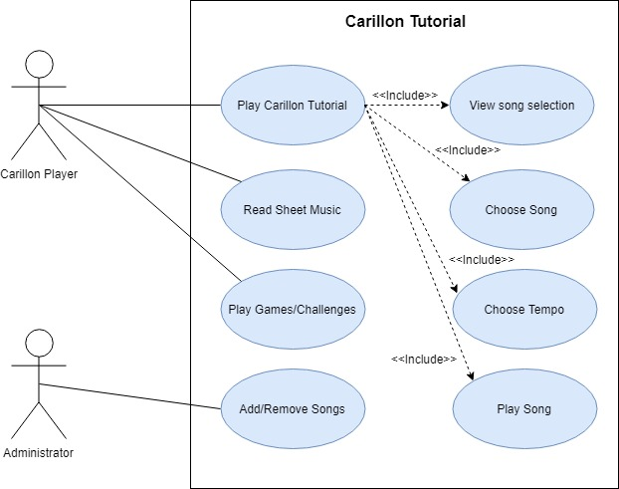
Functional Decomposition
User will choose “Play” then pick a song and difficulty
When the song is playing notes will start falling, which line up with the batons on the carillon
When a note reaches the bottom a light on the LED bar will light up above the baton that needs to be played
When the song ends the program goes back to the main menu
Notes:
Main menu -> Song selection -> difficulty selection -> Play -> Main menu

Slide 11
Functional Design
Program runs via a Windows PC
Connected to an Arduino, which controls the LED light bar
Runs entirely in C++
Uses the SFML graphics library
Minimalist
Simple to use
Portability
Battery solution which powers the monitor, computer, and components
Notes:
SFML: Portability allows it to be used on multiple OS’s

Slide 12
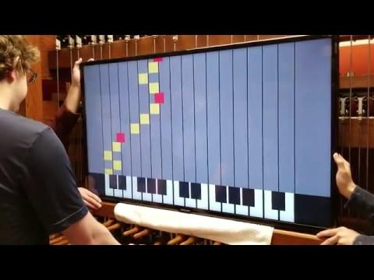
User Interface
Readability
Simplicity
Responsiveness

Slide 13
Hardware/Software Platforms
Hardware
Ultra-wide daylight monitor
LED light bar
Custom Arduino(PCB)
12V lead-acid battery
300W 10-15V inverter
12V battery level indicator(PCB)
Software
Windows 10 computer
Visual Studio with C++
SFML graphics library
Library for reading MIDI files
Notes:
Yicheng

Slide 14
Hardware Testing
LED brightness
Test power reaching from laptop to Arduino to LEDs
Monitor brightness
Test in multiple environments to ensure clarity
Power Efficiency
Test the power drop between the battery and the hardware
Battery Life
Test the battery life during all systems running
Notes:
Yicheng

Slide 15
Software Testing
Stress Tests for the Computer
Run MIDI files with large amounts of notes to see any performance loss
Reliability Tests
Test how many songs can be run without crashing
Multiple Songs
Add multiple songs to the list of playable songs
Different Difficulties
Does changing the difficulty to super slow or fast speeds break it
Does tutorial always transition to menu following the last note
Notes:
Gabe

Slide 16
Potential Risks & Mitigation
Battery temperature
Create a temperature monitoring system and shutdown system if unsafe
Include adequate cooling systems around heat-generating equipment
System will be moved around often
Ensure weight is manageable
Modify any external equipment to remove sharp edges or hazards
Isolate and secure any wires to prevent them from unplanned contact or dislocation during movement
Potential Problems with Unusual Monitor Resolution
Thoroughly test program at target resolution
Ensure functionality before monitor arrives
Notes:
Gabe

Slide 17
Prototypes
Original version inherited from sddec18-01 designed to run on Raspberry Pi
Notes:
Gabe

Slide 18
Project Status
Countless bug fixes made
Program wasn’t playing songs properly
Light bar fixes implemented
Considerably more stable
Program has been completely ported to Windows
Difficulty options have been added
Light bar functionality working
Updated UI for higher accessibility and visual appeal
Battery solution design complete
Notes:
Gabe

Slide 19
Contributions of Members
Software
Ryan
Gabe
Kienan
Sam
Hardware
Yicheng
Grant
Notes:
Ryan: UI updating, windows port, scrolling songs
Kienan: Light bar on Linux, difficulty selection, windows port

Slide 20
Future Plan
Implement sheet music mode
Bring more stability to the light bar implementation
Add more visually-pleasing graphical assets
Implement battery system
Begin work on Info Station
Notes:
Ryan

Slide 21
Questions?

Slide 22
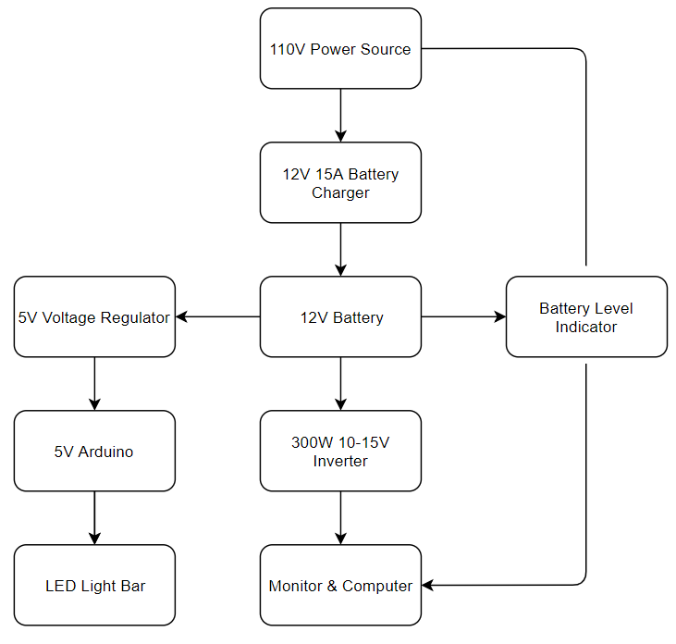
Power System
Battery: 100Ah 12V Lead-acid
Inverter: Over 85% power efficiency
Power: Less than 130W for all system
working time: 8 hours
Battery Level Indicator and Arduino: Custom made PCB
Notes:
Yicheng

